Slide 1

Visualizing Software Security
Richard Johnson richardj@microsoft.com

Slide 2
Opening Questions
How can we use the visualization tools we currently have more effectively?
How can the Software Development Lifecycle benefit from visualizations?
What is the impact of visualizations on our software security processes?

Slide 3
Visualization 101
What is visualization?
Information transmission through imagery
Why is visualization important?
Visualizations utilize the mind’s most perceptive input mechanism
What are the challenges in visualization?
Create intuitive spatial mappings of non-spatial data
Retain clarity while presenting highly dimensional data

Slide 4
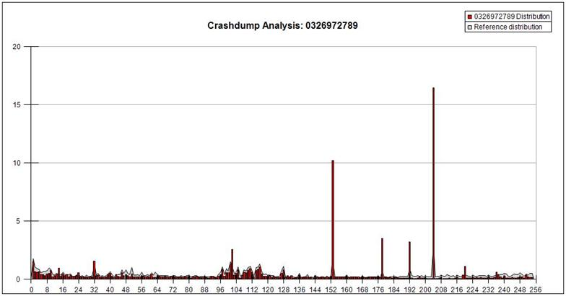
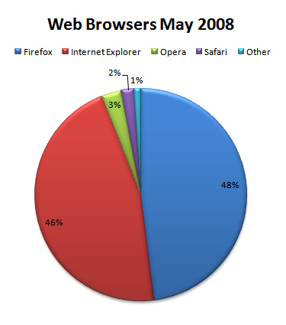
Visualization Taxonomy
Data Visualization

Slide 5
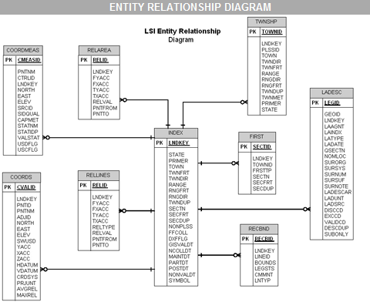
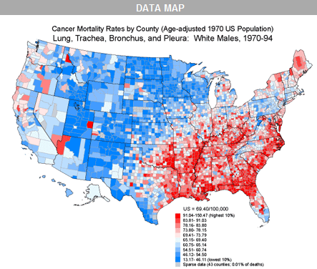
Visualization Taxonomy
Information Visualization

Slide 6
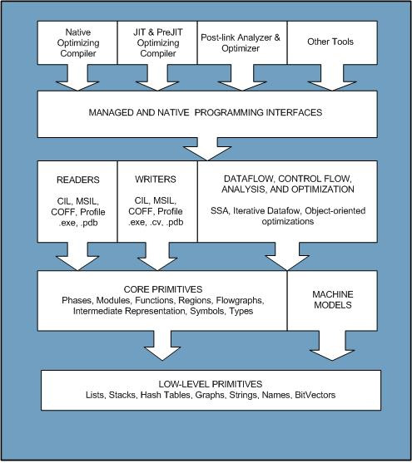
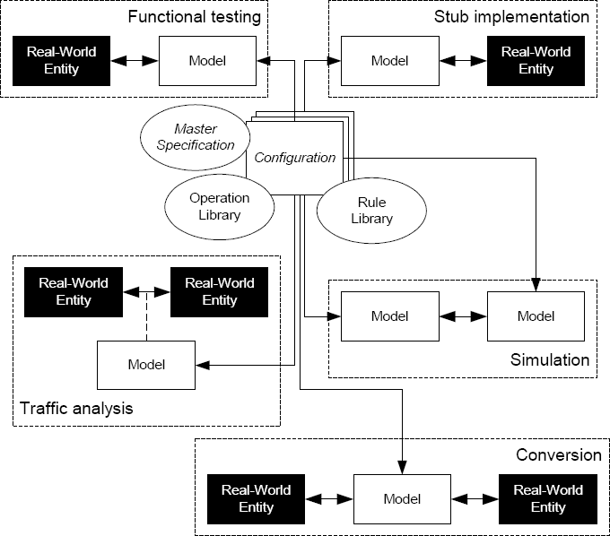
Visualization Taxonomy
Concept Visualization

Slide 7
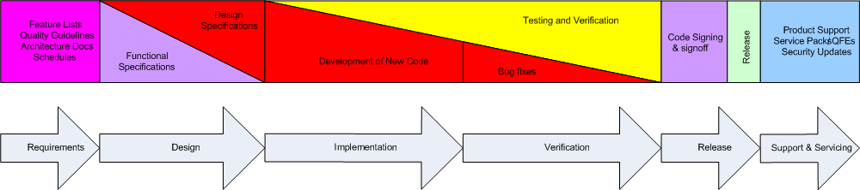
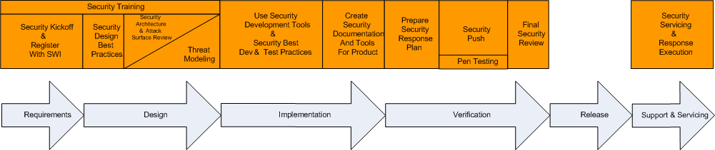
Visualization Taxonomy
Strategy Visualization

Slide 8
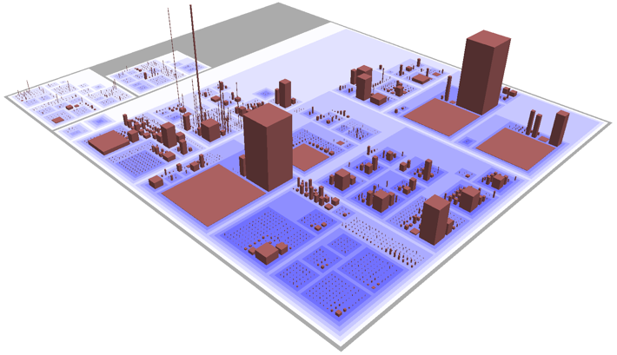
Visualization Taxonomy
Metaphor Visualization

Slide 9
Software Visualization
Problem Space
Program Visualization
Algorithm Visualization
Sourcing Data
Static vs Dynamic data
Inaccurate analysis tools
The goal is always: Reduce Complexity!

Slide 10
Static Software Properties
Structural Connectivity
Execution & Data Flow
Class Hierarchies
State Machine Models
Memory profile
Algorithm Complexity
Revision History
Age and authorship
Milestones in quality assurance

Slide 11
Dynamic Software Properties
Execution tracing
Code coverage
Indirect relationships
Dynamic dependencies
Memory tracing
Heap management patterns
Object instances
Taint propagation
Environment

Slide 12
Software Security Properties
Attack Surface Area
Dataflow entry points
Privilege boundaries
Implementation Flaws
Arithmetic flaws
Comparison flaws
Unchecked user input
Exploitability
Execution environment
Compiler security
Reachability
History
Code age
Author credibility

Slide 13
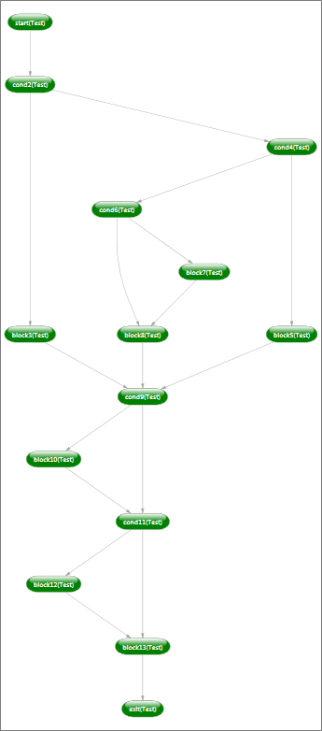
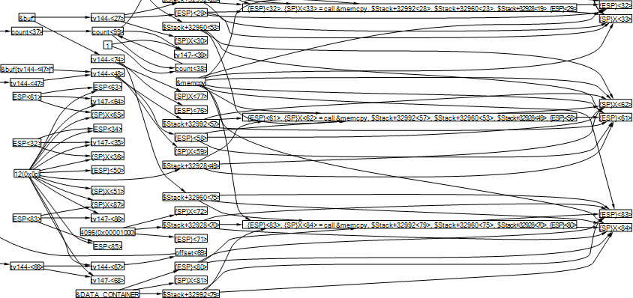
Graph Visualization
Hierarchical Layout
Layered by order of connectedness
Not for highly connected graphs

Slide 14
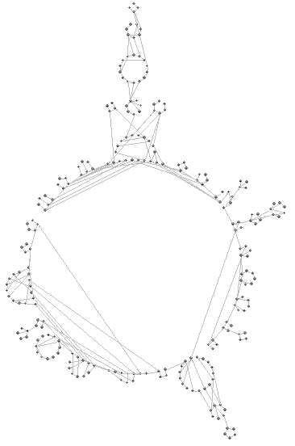
Graph Visualization
Circular
Nodes aligned on circles
Clustering

Slide 15
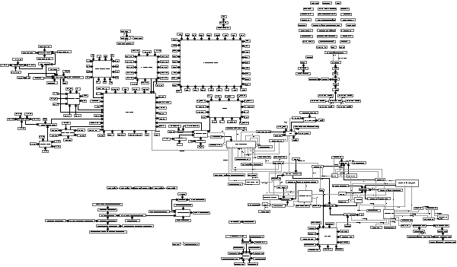
Graph Visualization
Orthogonal
Edges aligned on axes
Clustering

Slide 16
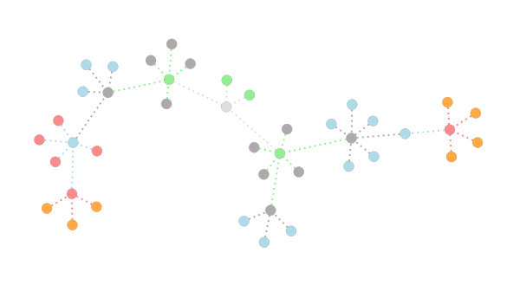
Graph Visualization
Force Directed
Spring, Magnetic, and Gravitational force
Packing

Slide 17
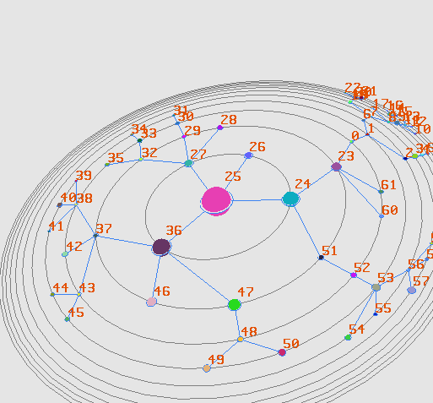
Improved Graph Visualization
Hyperbolic Space
Clarity on center focus
Packing

Slide 18
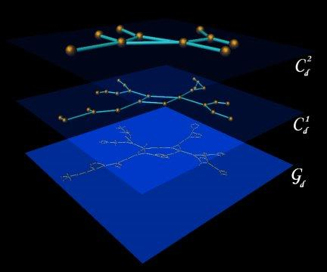
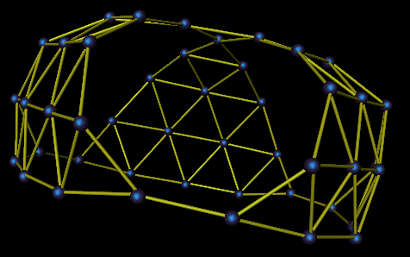
Improved Graph Visualization
Higher Dimensional Space
Clarity with high connectivity
Multi-level views

Slide 19
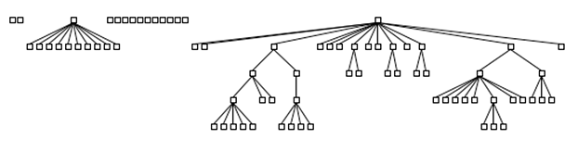
Visual Attributes
Nodes
Spatial coordinates
Spatial extents
Color
Shape
Edges
Color
Shape
Width
Style

Slide 20
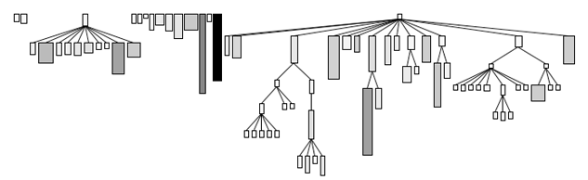
Visual Attributes
Nodes
Spatial coordinates
Spatial extents
Color
Shape
Edges
Color
Shape
Width
Style

Slide 21
Visual Attributes
Nodes
Spatial coordinates
Spatial extents
Color
Shape
Edges
Color
Shape
Width
Style

Slide 22
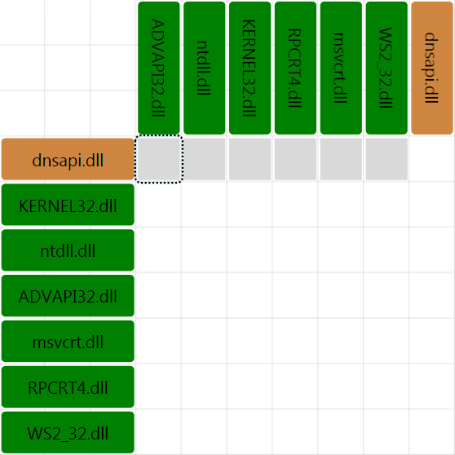
Visualizing Software Security
Observe binary interdependencies

Slide 23
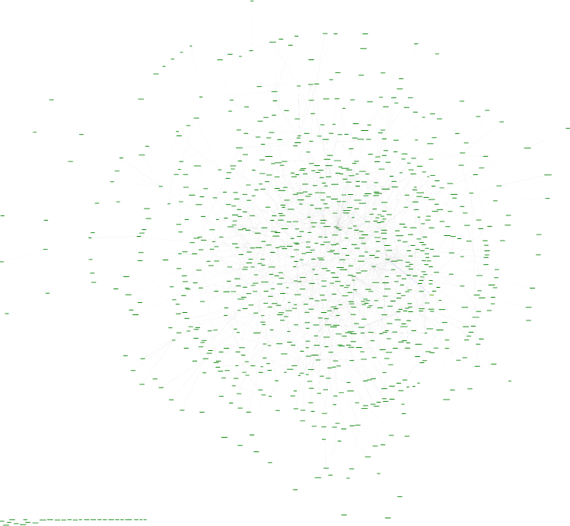
Visualizing Software Security
Acquire a method level control flow graph

Slide 24
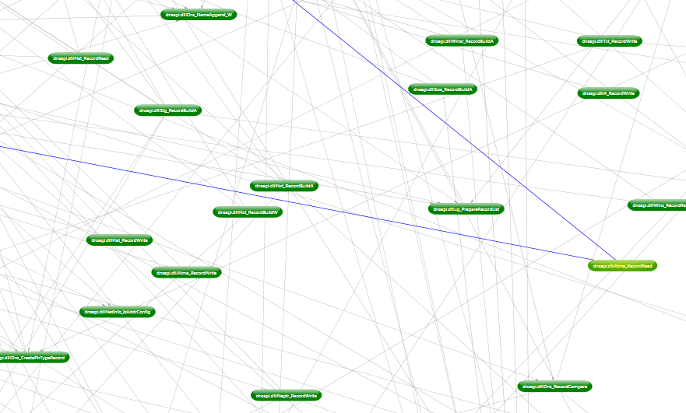
Visualizing Software Security
Acquire a method level control flow graph

Slide 25
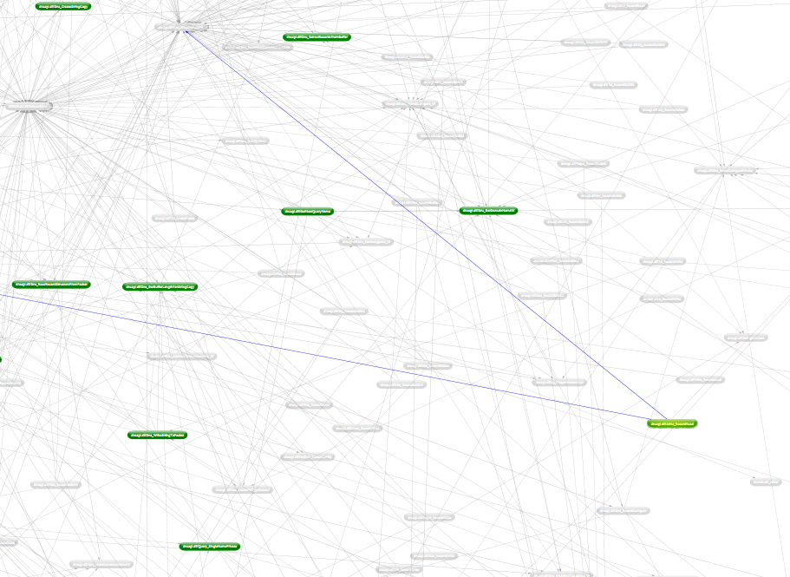
Visualizing Software Security
Reduce graph using code coverage data

Slide 26
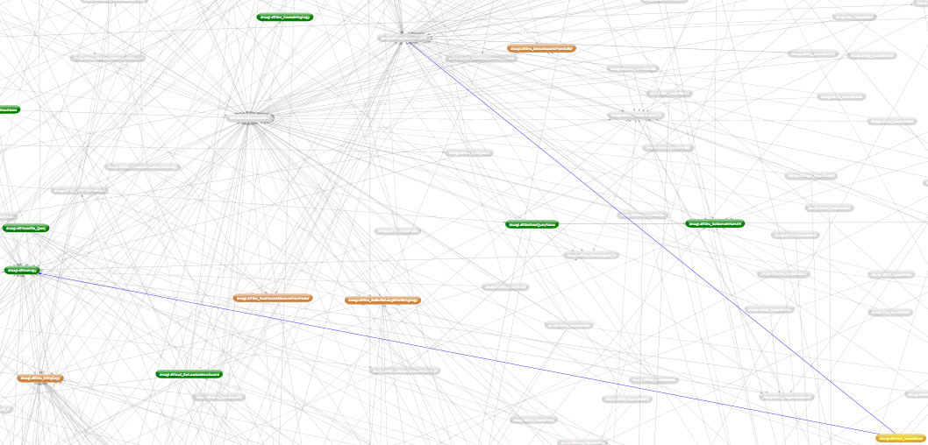
Visualizing Software Security
Trace dataflow dependency to discover taint propagation

Slide 27
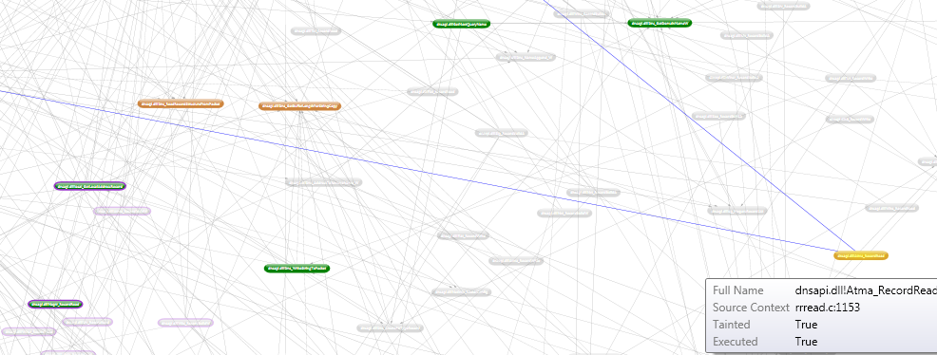
Visualizing Software Security
Use static analysis plugins to derive security properties such as GS and SafeSEH

Slide 28
Visualizing Software Security
Use static analysis plugins to derive security properties such as GS and SafeSEH

Slide 29
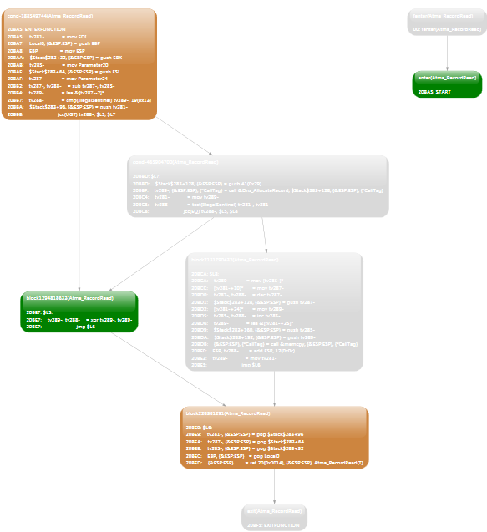
Visualizing Software Security
Analyze non-covered paths in tainted functions

Slide 30
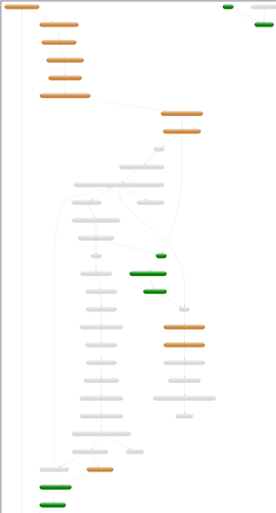
Visualizing Software Security
Analyze non-covered paths in tainted functions

Slide 31
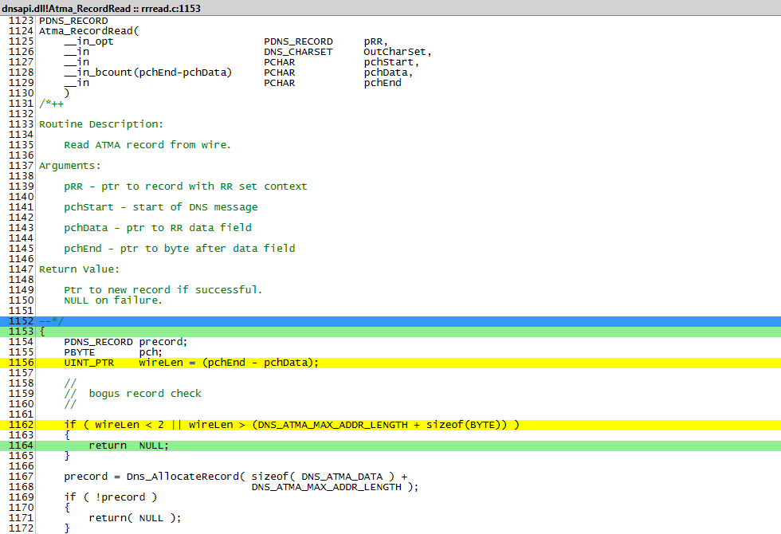
Visualizing Software Properties
Examine source code where correlations occur

Slide 32
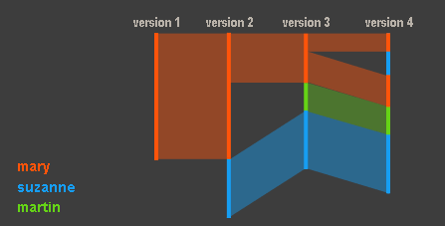
Beyond Graphs
Source Code Revision History
History Flow

Slide 33
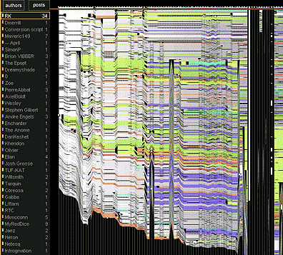
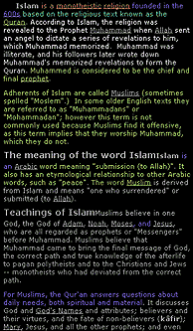
Beyond Graphs
Source Code Revision History
History Flow

Slide 34
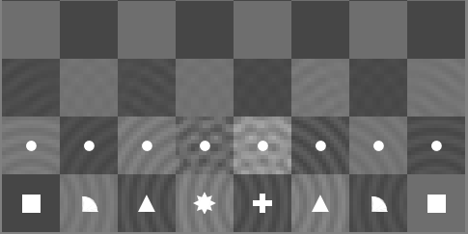
Beyond Graphs
State Machine Models
Thinking Machine

Slide 35
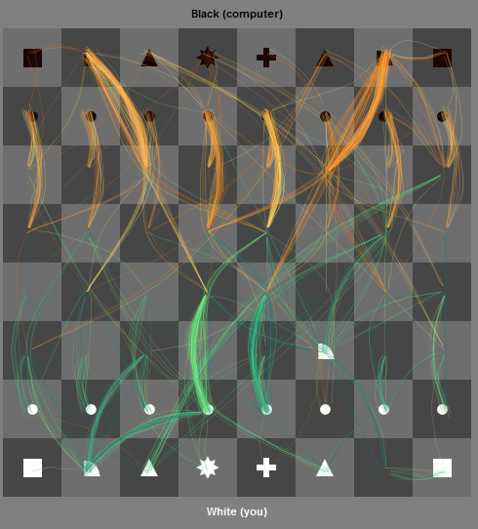
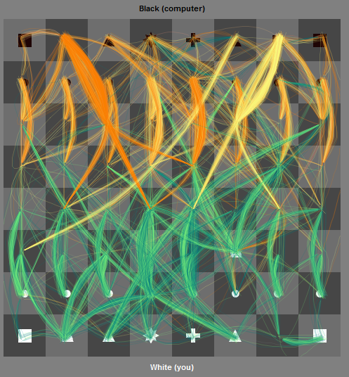
Beyond Graphs
State Machine Models
Thinking Machine

Slide 36
Questions?
Richard Johnson richardj@microsoft.com

Slide 37
Thank you! http://swiscience alias: pandora
Richard Johnson richardj@microsoft.com

